Slide 1

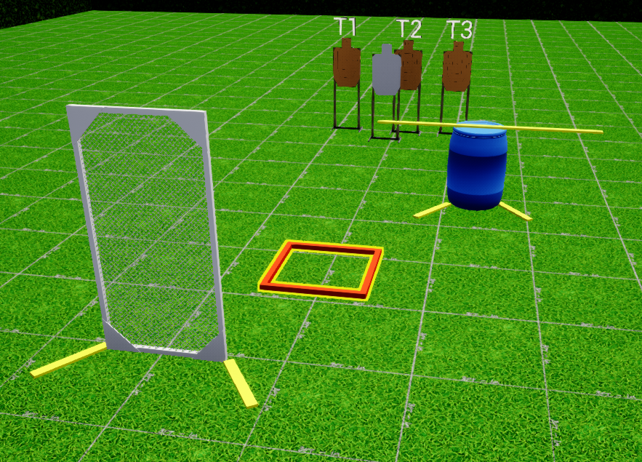
 | Interlake Sporting Association North Pistol, A Stage: High or Low Course Designer: Peter Jarvis
SCENARIO:
START POSITION: |  | STRINGS: 1 SCORING: Unlimited/Limited SCORED HITS: Best 2 ROUND COUNT: X TARGETS: 5 IDPA, 1 NT, 1 PP START-STOP: Audible - Last shot CONCEALMENT: Required Muzzle Safe Points: Muzzle safe markers / 180 degree rule SO NOTES:
STAGE PROCEDURE: At the start signal, NOTES:
P2
start
P1

